Slide 1
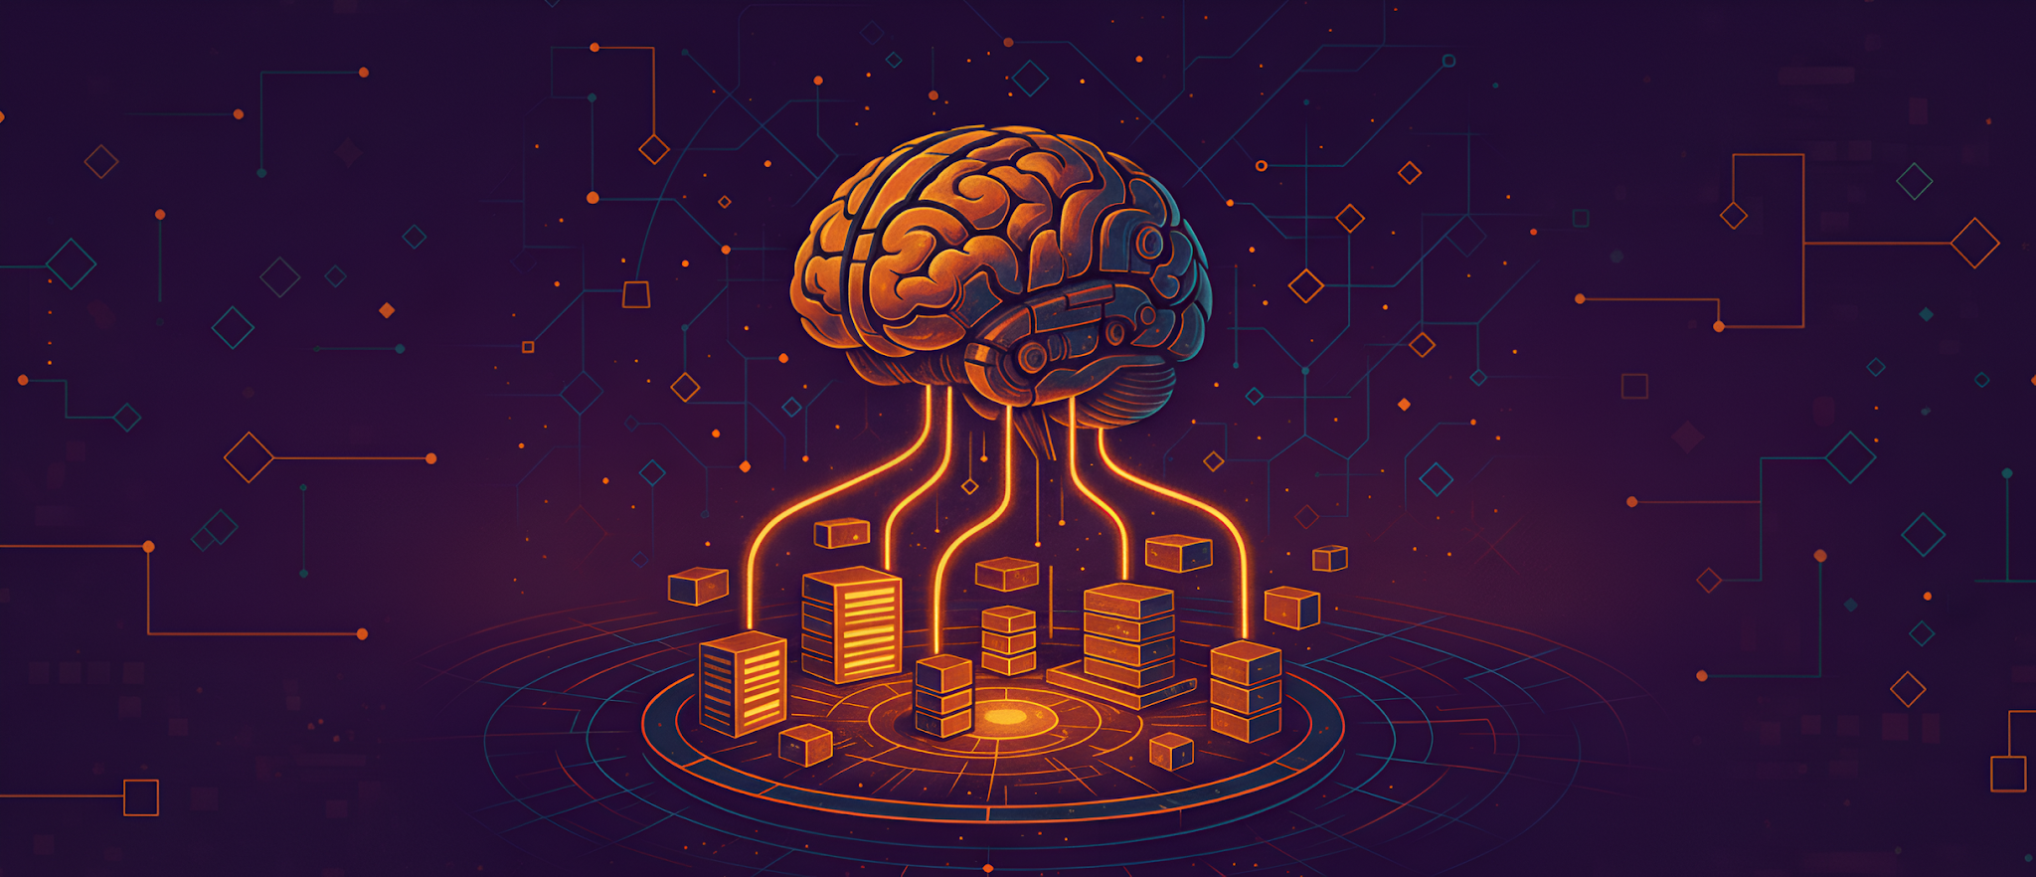
LLM Engineering
MASTER AI & LARGE LANGUAGE MODELS

Slide 2
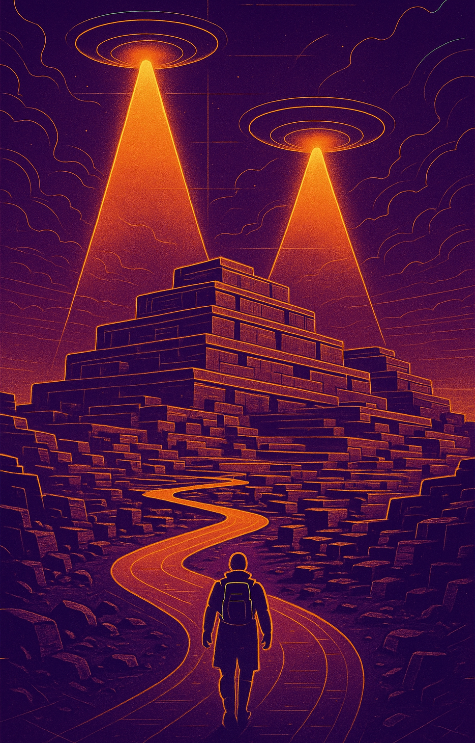
PROGRESS REPORT
LangChain, Vectors, Chroma!
What you can now do
Generate text and code with Frontier Models including AI Assistants with Tools, and with open-source models with Hugging Face transformers
Confidently choose the right LLM for your project, backed by metrics
Explain how RAG uses vectors and vector lookup to add context to prompts
By end of today you'll be able to
Describe the LangChain framework, with benefits and limitations
Work with popular encoders
Divide documents into chunks, make vectors, and store in the vectorstore Chroma

Slide 3


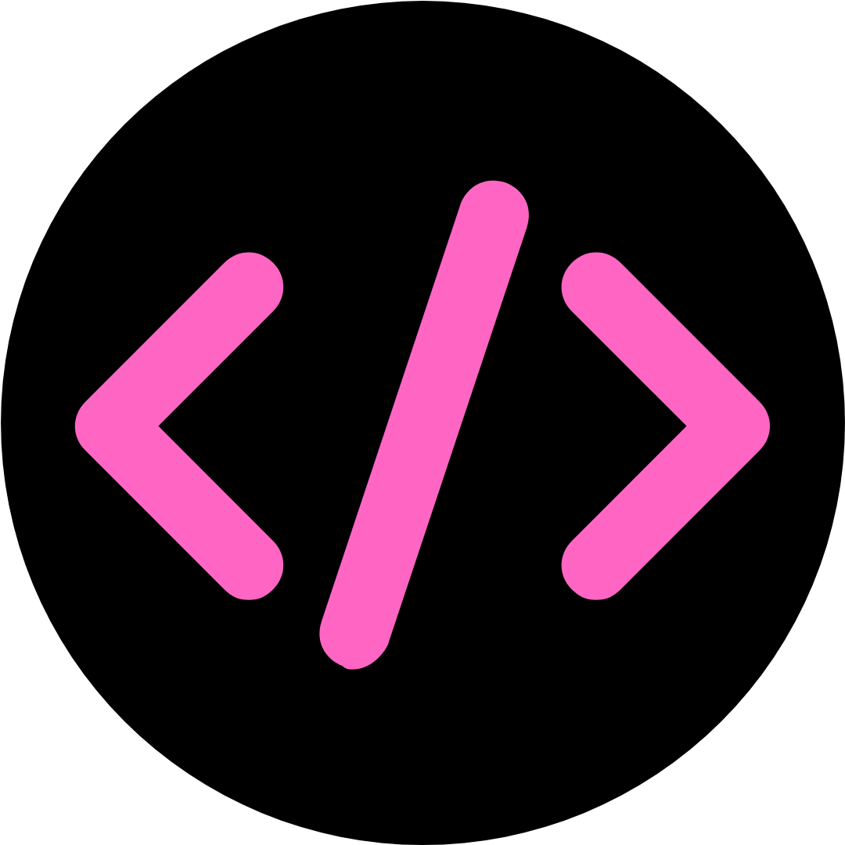

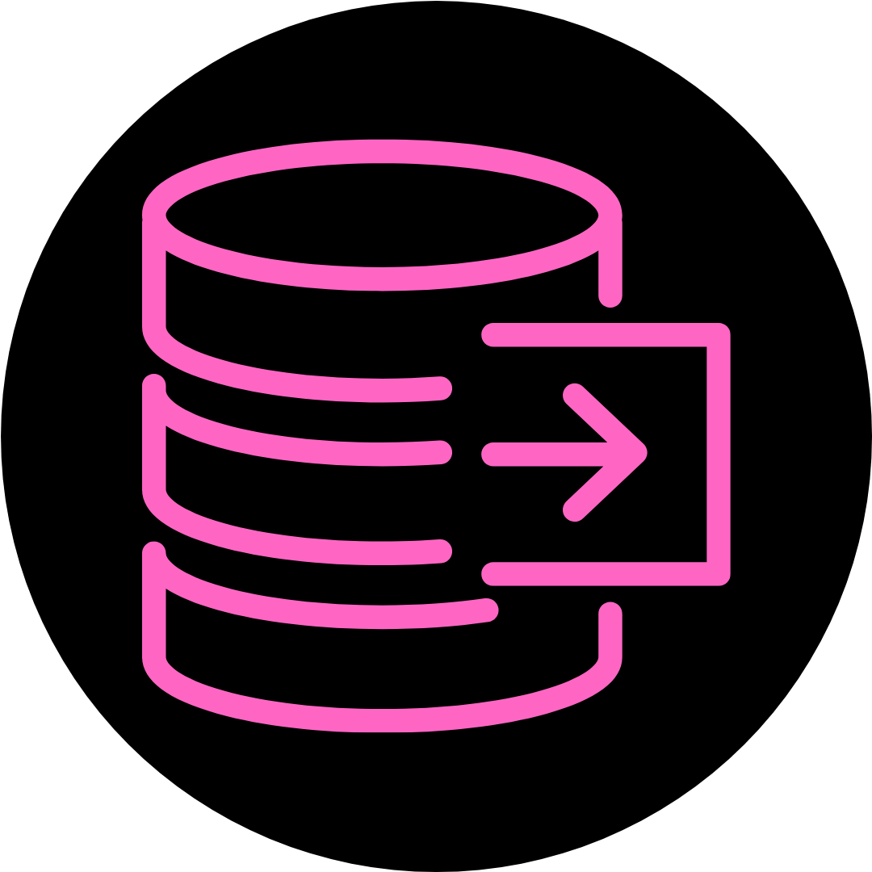
RECAP: The big idea behind RAG
Encoding LLM
Vectorize
Question
Prompt
Answer
Response
Chat
Code
LLM
Retrieve
Vector Datastore

Slide 4

INTRODUCING
LangChain
LangChain
Open Source framework launched in October 2022
Provides a common framework for interfacing with many LLMs
LangChain v1 released October 2025 with significant changes
Pros & Cons
Simplifies the creation of applications using LLMs (eg AI assistants, RAG, summarization) - fast time to market
Significant adoption in enterprise
As APIs for LLMs have matured, converged and simplified, the need for a unifying framework like LangChain has decreased - particularly with OpenAI endpoints
LangChain is a more heavyweight abstraction layer than LiteLLM and others, and some of its code can be ‘legacy’

Slide 5
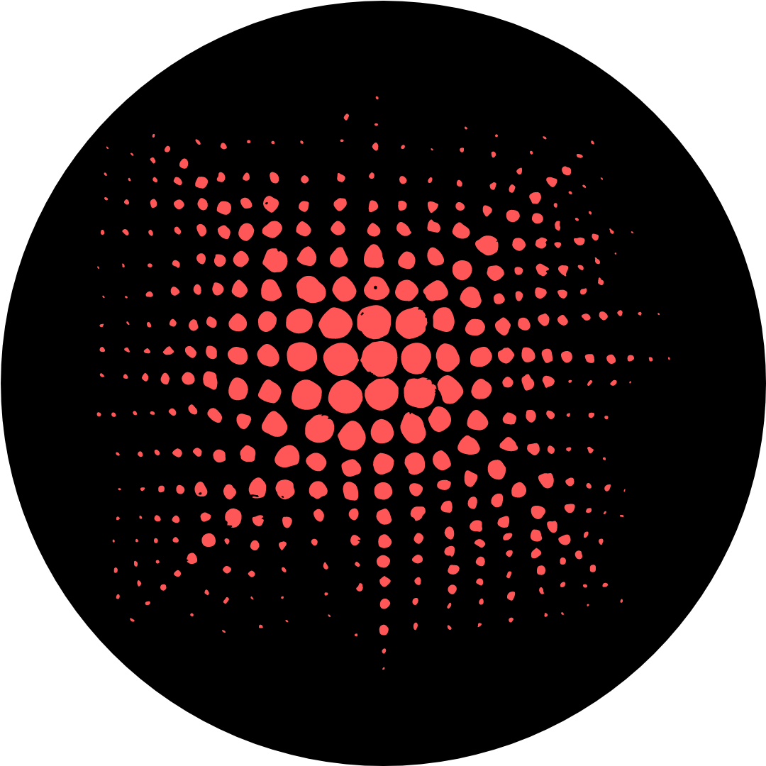
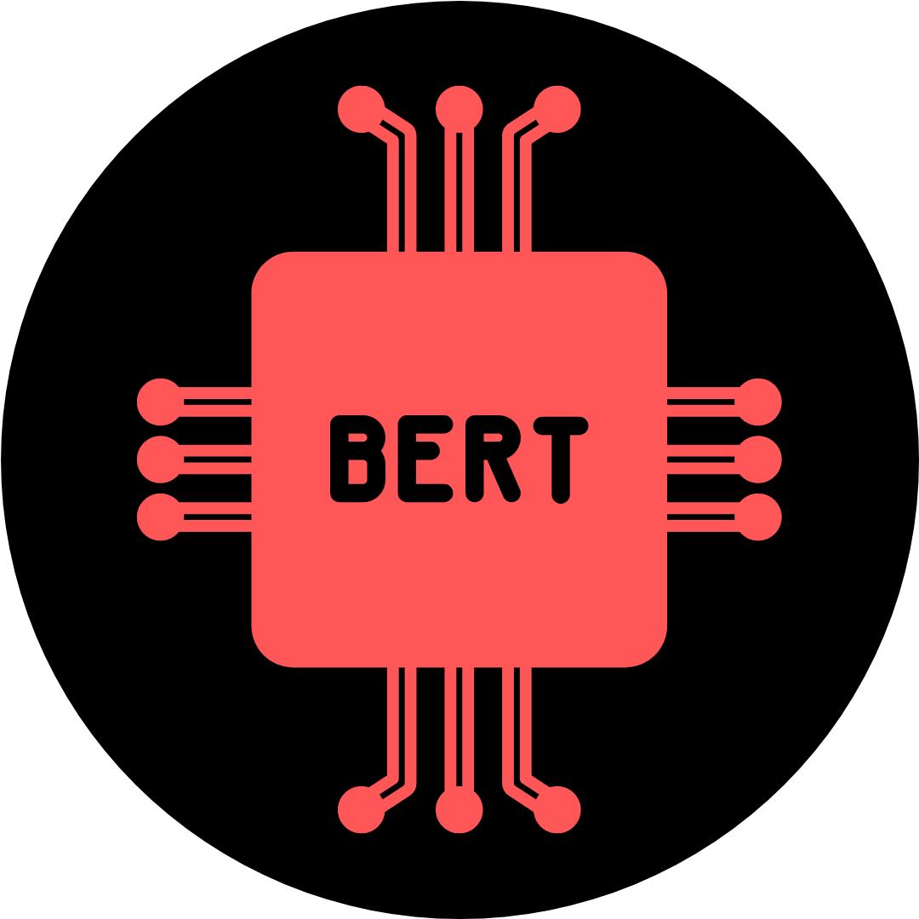

Encoder / Embedding Models
The Encoder Model turns text into a Vector Embedding. This is then stored in a Vector Database like Chroma.
word2vec (2013)
BERT (2018)
OpenAI
text embedding 3 small
text embedding 3 large
Google
gemini-embedding-001
Hugging Face Sentence Transformers
all-MiniLM-L6-v2

Slide 6

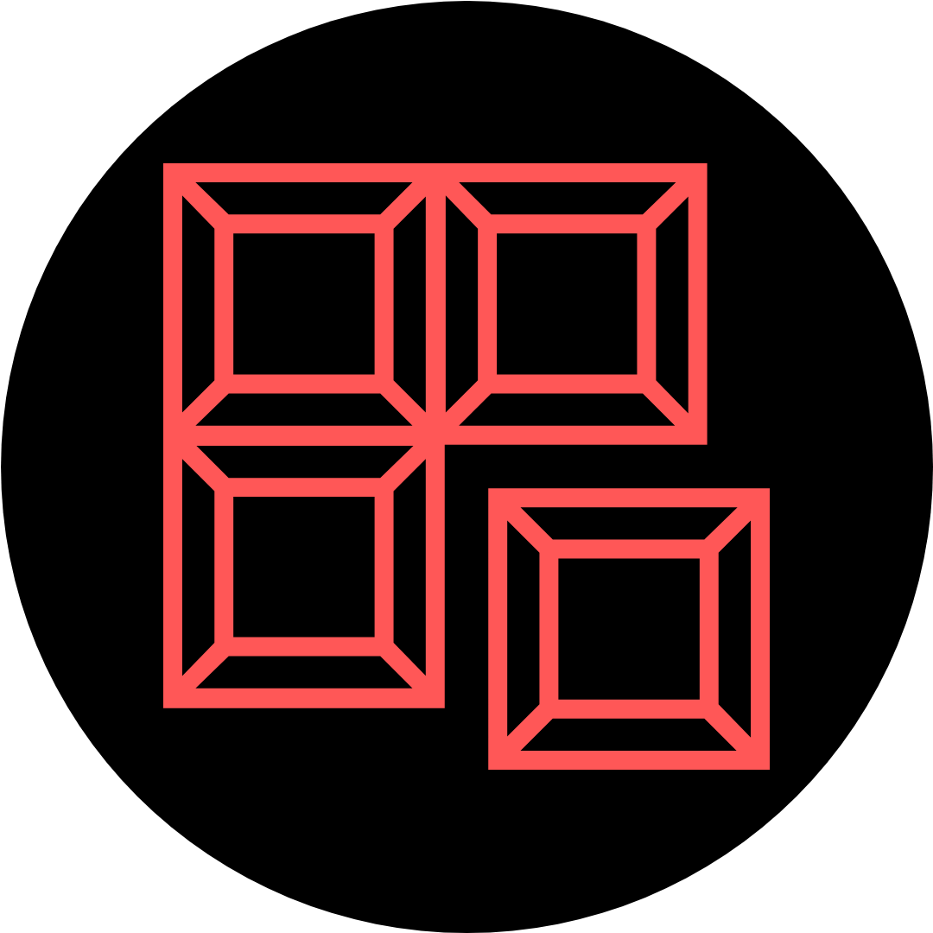

We will now use LangChain to load our Knowledge Base
Read in the documents in all folders
Divide into chunks
Vectorize and store
Keep in mind: the Encoder turns the text into a Vector. The Vector store is a Database that does quick lookup.
Popular Encoders:
OpenAI text embedding
Gemini embedding
Hugging Face all-MiniLM-L6-v2
Popular Vectorstores: Open-Source: Chroma, Qdrant, FAISS (in-memory) Paid & scalable: Pinecone, Weaviate, … Mainstream databases (Postgres, Mongo, Elastic, …)
The choice of Vector Database is largely unrelated to the vector calculation and is a cost / performance tradeoff

Slide 7

PROGRESS REPORT
55% Towards Mastering LLMs
What you can now do
Generate text and code with Frontier Models including AI Assistants with Tools, and with open-source models with HuggingFace transformers
Confidently choose the right LLM for your project, backed by metrics
Explain how RAG uses vector embeddings and vector datastores to add context to prompts, turn documents into chunks, vectorize and store in Chroma
By end of the next session you'll be able to
Use LangChain to build a RAG pipeline
Deliver a RAG-based expert question answerer
Create a Gradio based Chatbot for RAG application showing source documents

